Slide 1

SMART CART RIFD-Based Automatic Billing system
Revolutionizing Grocery Shopping

Slide 2
OVERVIEW
Smart-Cart is a groundbreaking RFID-based automatic billing system designed to transform the traditional grocery shopping experience. This innovative project aims to streamline and enhance the way we shop by automating the item scanning and billing processes. Using a combination of Arduino technology, RFID readers, and a user-friendly interface, Smart-Cart provides shoppers with a convenient, efficient, and secure means of payment. This system not only benefits customers but also offers a potential game-changer for retailers seeking to improve service and boost operational efficiency. Explore how Smart-Cart is revolutionizing grocery shopping and paving the way for future applications in retail automation.

Slide 3
Importance and Relevance: Smart-Cart improves the shopping experience, streamlining billing and enhancing customer satisfaction, while also addressing operational efficiency for retailers.
Objective: Automated item scanning, Efficient billing, RFID payment system, Enhanced customer experience, Retail operational efficiency, Exploration of broader retail automation applications.

Slide 4
LIST OF COMPONENTS:
Arduino Uno
16x2 LCD Display (12C)
4x4 Matrix Keypad
MFRC522 RFID Reader
6 RFID Tags
1 Green LED
1 Red LED
Buzzer
Jumper wires
Resistors
Connector cable

Slide 5

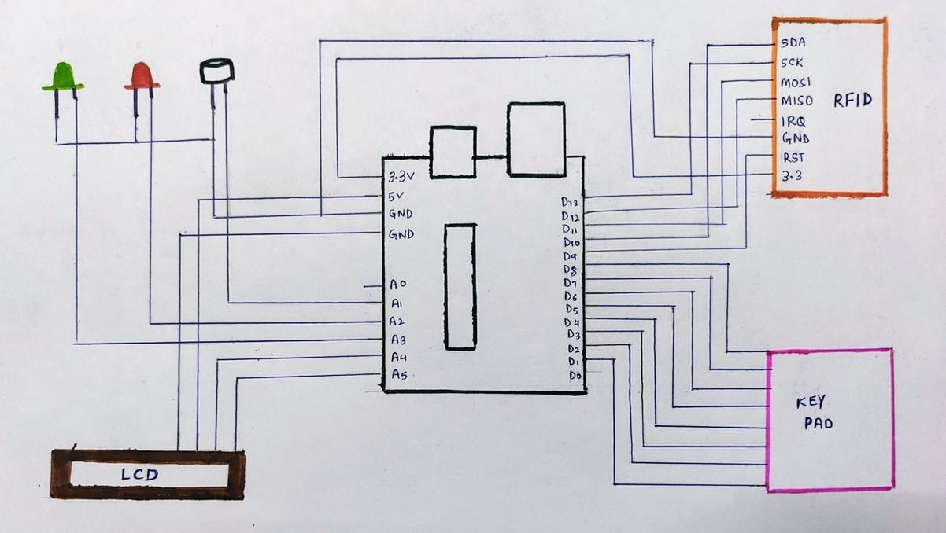
Title Slide 3
Arduino Uno16x2 LCD Display (I2C)4x4 Matrix KeypadMFRC522 RFID Reader6 RFID Tags1 Red LED1 Green LEDBuzzer

